Slide 1

Data Analysis - Bank Telemarketing Data

Slide 2
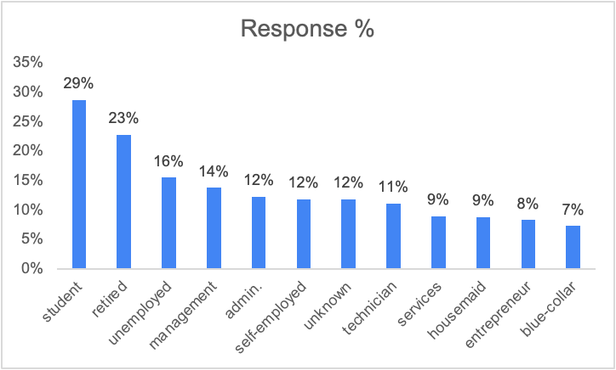

Students and Retired Individuals are the most promising customers.
Highlights:
The average positive response rate of the overall data is roughly around 12%.
The response rate of students(~29%) and retired individuals(~23%) is way more than the overall average.

Slide 3
Students and Retired Individuals are the most promising customers.
Row Labels | picked up the call | said yes | Average of response
student | 938 | 269 | 29%
retired | 2264 | 516 | 23%
unemployed | 1303 | 202 | 16%
management | 9458 | 1301 | 14%
admin. | 5171 | 631 | 12%
self-employed | 1579 | 187 | 12%
unknown | 288 | 34 | 12%
technician | 7597 | 840 | 11%
services | 4154 | 369 | 9%
housemaid | 1240 | 109 | 9%
entrepreneur | 1487 | 123 | 8%
blue-collar | 9732 | 708 | 7%
Grand Total | 45211 | 5289 | 12%
Highlights
The sample data for students and retired individuals is also sufficient to prove it to be a good target segment.

Slide 4
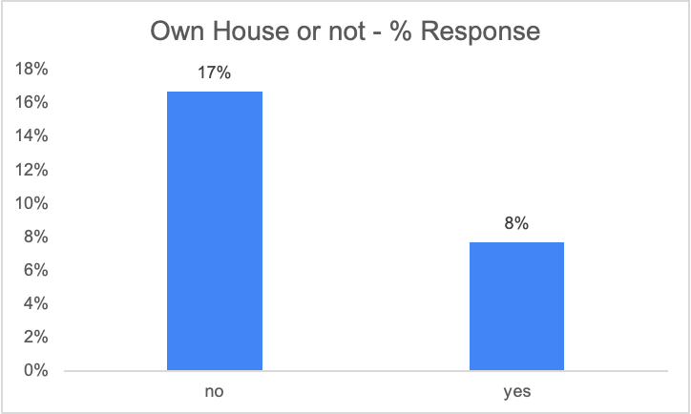
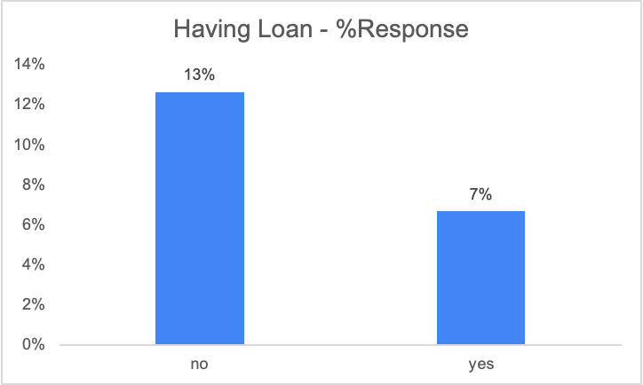
People who do not have a house and do not have an outstanding loan show a higher tendency to buy the product
Highlights
~8% of people who have a house bought the product whereas ~17% of people who do not have the house bought the product which is way more than overall average of ~12%.
Similar trend is observed with people who don’t have a loan where ~13% who don’t have loan bought the product vs ~7% people who have a loan bought the same product.

Slide 5
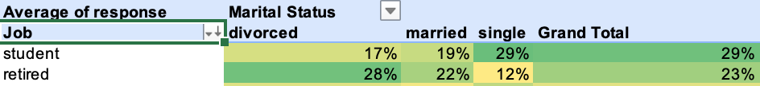
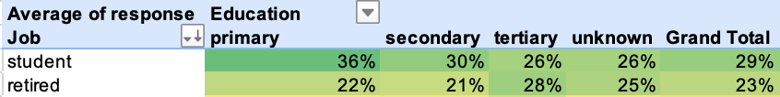
Almost all segments of students and retired individuals based on marital status and education are promising and have an average response rate greater than 12%
Highlights:
We can conclude that there is no segment under students and retired individuals which is an outlier and which can be ignored.

Slide 6
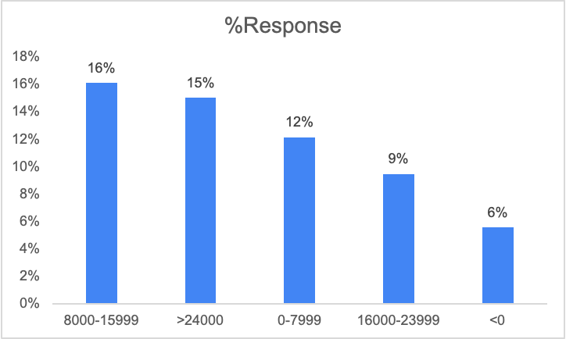
People having negative account balance are a big red flag!!
Highlights:
~6% is the average response rate/ average buying percentage of people who have account balance less than 0.
This segment can be safely avoided.

Slide 7
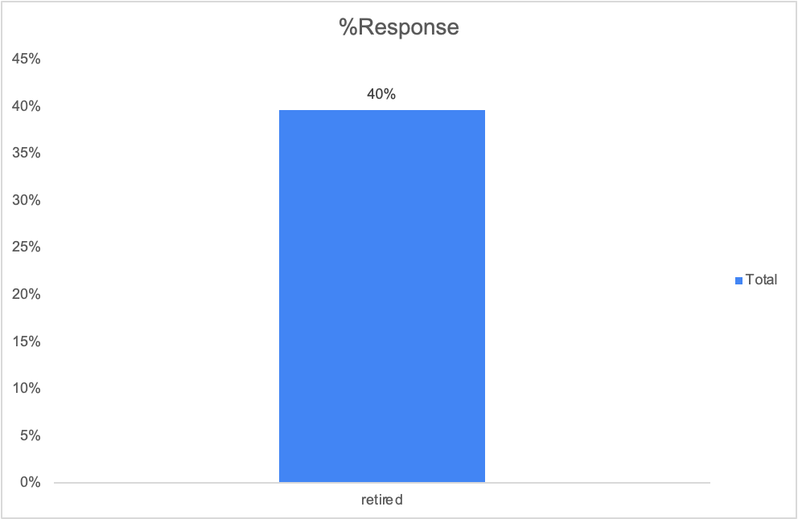
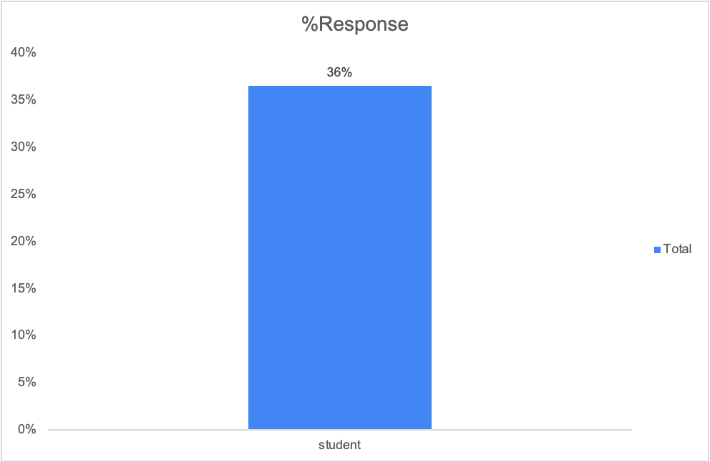
Conclusion: Students and Retired individuals(age above 60 years) who do not own a house, have positive account balance and who do not have a loan should be targeted in the next campaign.
Highlights:
~36% and ~40% students and retired individuals respectively, who do not own a house, have positive account balance and do not have a loan bought the product.

Slide 8

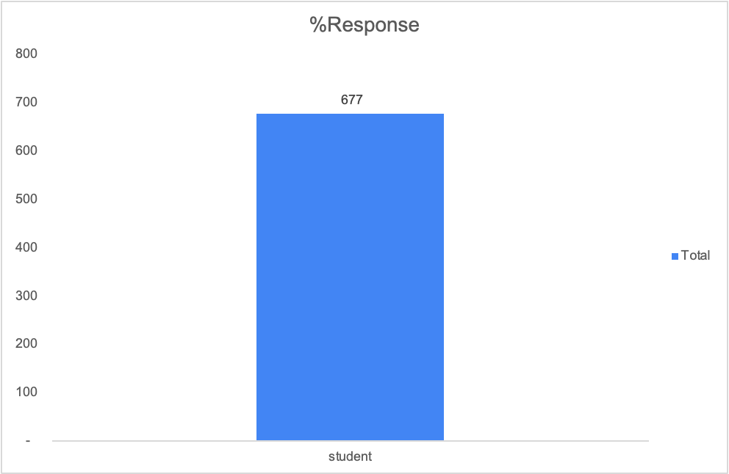
Conclusion: Students and Retired individuals(age above 60 years) who do not own a house, have positive account balance and who do not have a loan should be targeted in the next campaign.
Highlights:
~36% and ~40% students and retired individuals respectively, who do not own a house, have positive account balance and do not have a loan bought the product.
Also, we have verified the dataset. There is good amount of data in both the final target segments of students(677) and retired individuals(949).

Slide 9
THANK YOU!

